Slide 1

Measure Y
City of Chino
A June 2022
Ballot Measure

Slide 2
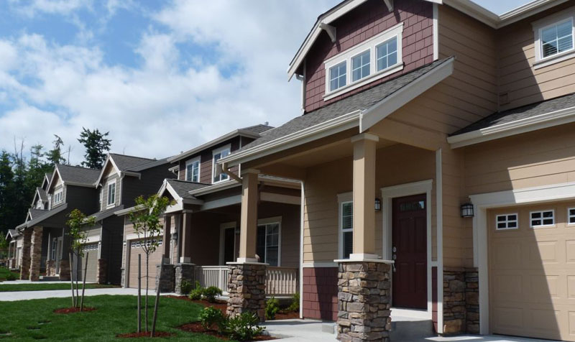
Why Housing Matters
City of Chino – Measure Y
New housing and land use updates are essential components of effective regional planning
Strong land-use policies advance affordability, sustainability, and equity
Stable housing is a foundation for family economic well-being and is essential to thriving communities
Strong local housing strategies = meeting city-wide economic objectives
Not enough housing is being built to accommodate for population growth

Slide 3
Managing Local Development
City of Chino – Measure Y
On November 8, 1988, the people of Chino Adopted Measure M to amend the General Plan
Measure M only applies to territory that was within Chino’s geographical boundaries as of November 8, 1988
Measure M prohibits the City Council from increasing residential density or rezoning non-residential land for residential uses without a vote of the people
To update its Housing Element, Chino needs to rezone non-residential land
A compliant Housing Element requires compliance with Measure M

Slide 4
What is the Housing Element?
City of Chino – Measure Y
The Housing Element is one of the eight State mandated elements of the City’s General Plan
The purpose of the Housing Element is to identify and plan for the existing and projected housing needs
The City of Chino is required by State law to update its Housing Element every eight years
In January 2022, the City of Chino adopted its 6th cycle Housing Element Update for 2021 – 2029
Chino receives State funding because it has a compliant Housing Element
Why is the Housing Element updated?
  Compliance with State housing laws
  Eligibility for State grants and funding resources
  Avoid penalties imposed by the State

Slide 5






Housing Element – Public Engagement
City of Chino – Measure Y
400+
Residents Responded to an Online Survey
Publicly Accessible Study Sessions
2
Interactive Community
Workshops
Housing Element Committee with Local Stakeholders and Residents Advising
6
Public Meetings
City Council Hearings

Slide 6
What Determines Housing Needs? RHNA
City of Chino – Measure Y
California’s Regional Housing Needs Assessment (RHNA) is a process for determining future housing need
Based on growth in population, household size, and employment status
RHNA process is required by State law and aims for fair housing supply across equitable income levels
RHNA is completely managed through the State - California Department of Housing and Community Development (HCD)
Cities use RHNA to:
  Develop land-use plans
  Prioritizing local resource allocation
  Address existing and future housing needs resulting from statewide population, employment, and household growth
Current RHNA allocations are unprecedented with some cities facing nearly a 300 percent increase from their previous cycle

Slide 7
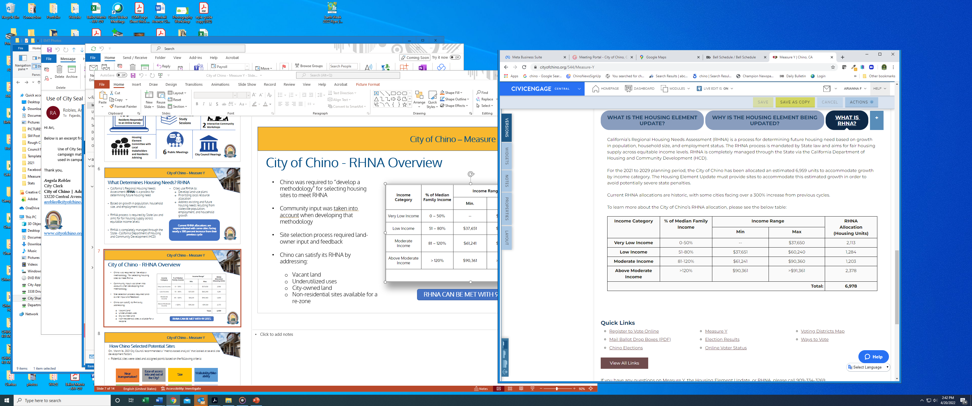
City of Chino - RHNA Overview
City of Chino – Measure Y
Chino was required to “develop a methodology” for selecting housing sites to meet RHNA
Community input was taken into account when developing that methodology
Site selection process required land-owner input and feedback
Chino can satisfy its RHNA by addressing:
  Vacant land
  Underutilized uses
  City-owned land
  Non-residential sites available for a re-zone
RHNA CAN BE MET WITH 91 SITES

Slide 8
How Chino Selected Potential Sites
City of Chino – Measure Y
On, March 16, 2021 City Council recommended a “metrics-based analysis” that looked at several site development factors
Potential sites were rated and assigned points based on the following criteria:
Near transportation?
Ease of access into and out of the City?
What are the adjacent uses?
Size
Walkability/Bike-ability
Near a Park/Open Space?
Near amenities?
Does it disrupt?

Slide 9
Fulfilling RHNA
City of Chino – Measure Y
City of Chino site strategy resulted in the creation of two Overlay Zones
      Affordable Housing Overlay (AFF-OV)
        44 sites
      Mixed-Use (MU-OV) Overlay
        47 sites
      Both Overlay Zones = 1.2 percent of the total land area of Chino
      All identified parcels within the Overlay Zones = 0.34 percent of the total parcels in Chino

Slide 10
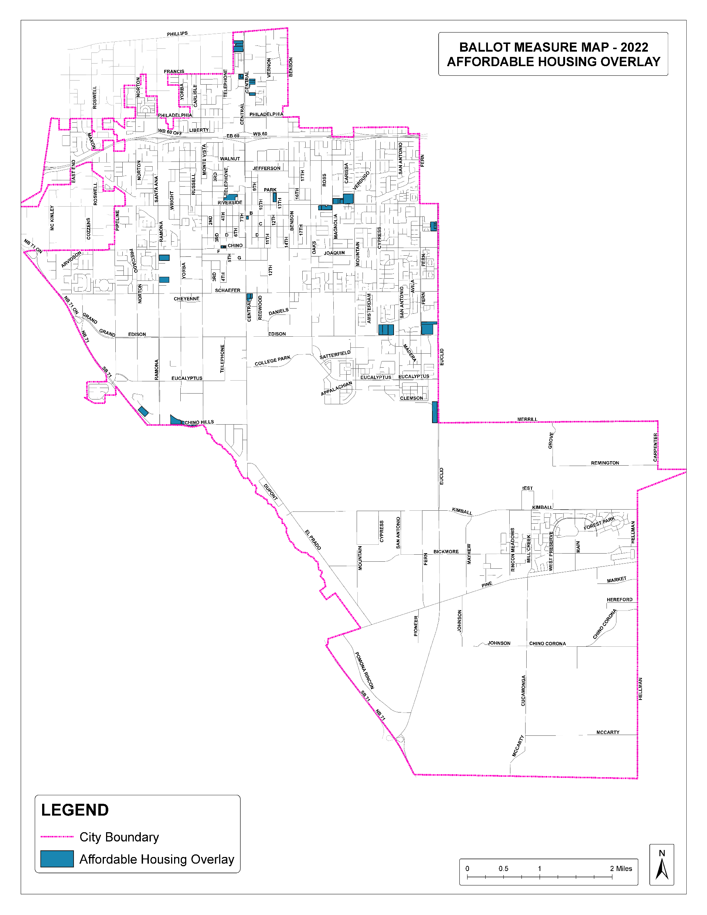
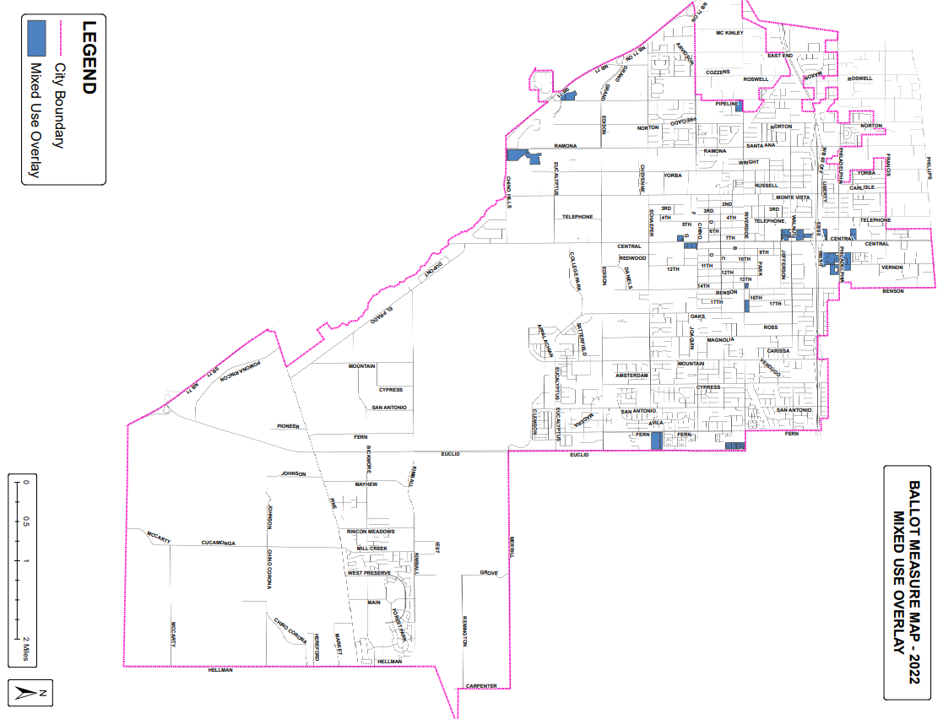
AFF-OV Affordable Housing Overlay
City of Chino – Measure Y

Slide 11
MU-OV Mixed-Use Overlay
City of Chino – Measure Y

Slide 12
Fulfilling RHNA = A Compliant Housing Element
City of Chino – Measure Y
Updating a Housing Element can be daunting and a lot is at stake
Individuals and families are directly affected by a jurisdiction’s ability to plan for housing needs
State funding for transportation, infrastructure, and housing require or consider compliance with Housing Element law
Funds are competitive and can be used for fixing roads, adding bike lanes, improving transit, providing affordable housing options, etc.

Slide 13
Introducing Measure Y
City of Chino – Measure Y
Measure Y, if approved by voters, will permit the use of the Two Overlay Strategy and would enable Chino to meet its RHNA goals
Approval of Measure Y will allow for a compliant Housing Element
Denial of Measure Y will mean a non-compliant Housing Element
Non-compliance can turn local control over to the State
Non-compliance could = prohibition from disapproving housing developments, suspended authority to issue zoning approvals, financial penalties, losing opportunities for State grant funding, and more
Measure Y, on the June 2022 ballot, only addresses the proposed Two Overlay Strategy as it relates to the 2021-2029 Housing Element Update
Measure M remains intact as-is and is not changed

Slide 14

For More Information
City of Chino – Measure Y
Website: www.cityofchino.org/MeasureY
Phone: 909-334-3250
Email: housing@cityofchino.org
Facebook, Instagram, Twitter, Nextdoor: @cityofchinogov

